Slide 1


Data Analytics Skills Enhancement
Date: 19th August 23 :: Time: 11 am IST

Slide 2
Data Analytics Skills Enhancement
1. Introduction:
There is a need to succeed and remain competitive in the Data Analytics Job Market.
You need to learn the tools that may benefit you in the future.
You need to consider the tools that best fit your job title, industry and professional needs.
Top data analytics skills to master for successful career in Data Analytics field:
1. Structured Query Language (SQL)
2. R & Python
3. Data Visualization tool: Tableau, Power BI
4. Data Collection and cleaning: OpenRefine
5. Data Modelling tool: diagrams.net (aka draw.io)
6. Data Mining tool: Orange, KNIME

Slide 3

Data Analytics Skills Enhancement
2. Data Cleaning tool (OpenRefine):
OpenRefine is a powerful free, open source tool for working with messy data: cleaning it; transforming it from one format into another; and extending it with web services and external data.
This tool cleans, reshapes and edits batch, unstructured and messy data.
OpenRefine is a standalone application that has a web interface. It is not hosted on the web but can be downloaded and runs on the local machine.
Website: https://openrefine.org/
History
OpenRefine was formerly known as Google Refine. It was also called Freebase Gridworks and developed by Metaweb Technologies, Inc. in May 2010.
In July 2010 Google acquired Metaweb and by extension, Freebase and Gridworks. Freebase Gridworks has been renamed Google Refine.

Slide 4
Data Analytics Skills Enhancement
2. Data Cleaning tool (OpenRefine)- continued:
It operates on rows of the data that have cells under columns, which is very similar to relational tables.
Operations in OpenRefine include faceting (allowing users to narrow down results through several different dimensions), clustering, and reconciling, which all help in the data cleaning process. It also analyzes the data through filtering, faceting and converting the data into more structured form.
Transformation expressions can be written in General Refine Expression Language (GREL), Jython (i.e. Python) and Clojure. Since it is an open source project, its code can be reused in other projects.
Alternative tool: Talend Open Studio from Talend

Slide 5
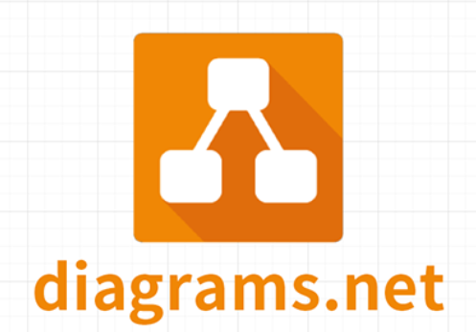
Data Analytics Skills Enhancement
3. Data Modelling tool (diagrams.net):
diagrams.net (previously draw.io) is a cross-platform graph drawing software developed in HTML5 and JavaScript. A file with a “.drawio” extension is a drawing file created with diagrams.net's draw.
Its interface can be used to create diagrams such as flowcharts, wireframes, UML diagrams, organizational charts, and network diagrams.
The software lets you choose from an automatic layout function, or create a custom layout. They have a large selection of shapes and hundreds of visual elements to make your diagram. The drag-and-drop feature makes it simple to create a great looking diagram or chart.
History
JGraph by Gaudenz Alder and David Benson, UK - Year 2000
draw.io - Year 2012
diagrams.net - Year 2020
Alternative tool: Visio is the original flowchart maker made my Microsoft.

Slide 6
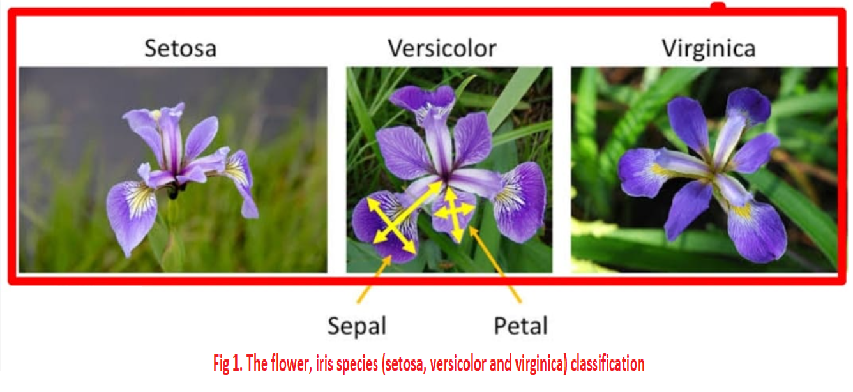
Data Analytics Skills Enhancement
Case Study:
The Iris flower data set or Fisher's Iris data set is a multivariate data set used and made famous by the British statistician and biologist Ronald Fisher in 1936.
The data set consists of 50 samples from each of three species of Iris (Iris setosa, Iris virginica and Iris versicolor). Four features were measured from each sample: the length and the width of the sepals and petals, in centimeters. Based on the combination of these four features, Fisher developed a linear discriminant model to distinguish the species from each other. Refer https://en.m.wikipedia.org/wiki/Iris_flower_data_set
We are trying to distinguish the species from each other visually using charts such as Box Plots, Scatter Plots and Scatter Plots using the Orange tool and Power BI tool.

Slide 7
Data Analytics Skills Enhancement
4. Data Mining tool (Orange):
Orange is a C++ core object and routines library that incorporates a huge variety of standard and non-standard machine learning and data mining algorithms. An “.ows” file saves the connections between the widgets and all of the parameter values or settings in xml format..
It is an open-source data visualization, data mining, and machine learning tool. Orange is a scriptable environment for quick prototyping of the latest algorithms and testing patterns.
It is a group of python-based modules that exist in the core library. It implements some functionalities for which execution time is not essential, and that is done in Python.
Orange consists of a canvas interface onto which the user places widgets and creates a data analysis workflow. Widgets offer basic functionalities such as reading the data, showing a data table, selecting features, training predictors, comparing learning algorithms, visualizing data elements, etc. The user can interactively explore visualizations or feed the selected subset into other widgets.

Slide 8
Data Analytics Skills Enhancement
4. Data Mining tool (Orange)- continued:
History
In 1996, the University of Ljubljana and Jožef Stefan Institute started development of ML*, a machine learning framework in C++.
In 1997, Python bindings were developed for ML*, which, together with emerging Python modules, formed a joint framework called Orange.
Alternative tool: KNIME® is an open source data analytics, reporting and integration platform.

Slide 9
Data Analytics Skills Enhancement
5. Visualization tool (Power BI):
Power BI is a cloud-based business analysis and intelligence service by Microsoft. It is a collection of business intelligence and data visualization tools such as software services, apps and data connectors.
Power BI is a unified, scalable platform for self-service and enterprise business intelligence (BI). It converts data from different data sources to interactive dashboards and BI reports.
PBIX file extension is a file format used by Microsoft Power BI.
History
Crescent, designed by Ron George 2010
Power BI, unveiled by Microsoft in 2013
Alternative tool: Tableau by Salesforce.

